Slide 1

Correlation Concept

Slide 2
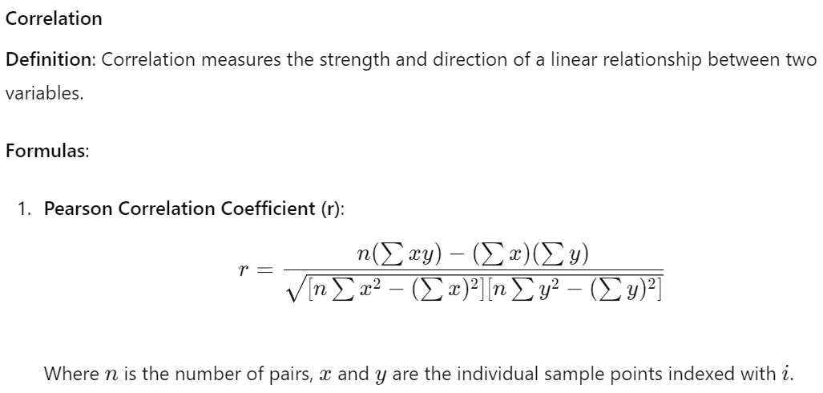















Slide 3
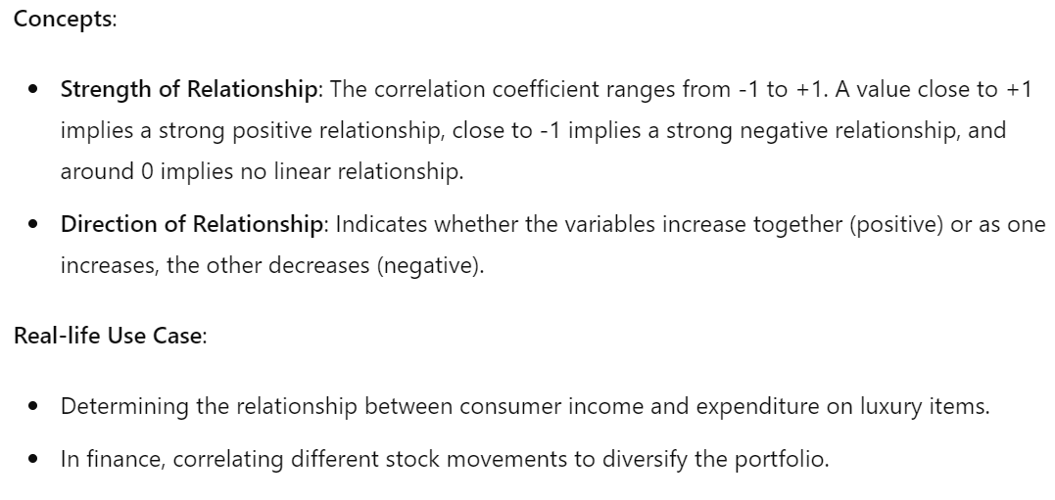













Slide 4




Correlation Matrix

Slide 5
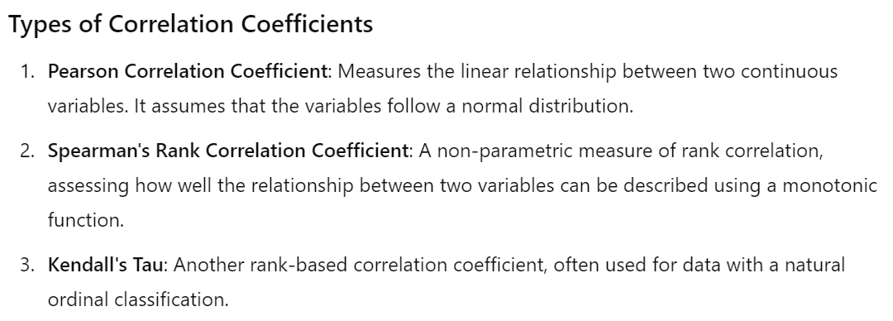






Slide 6
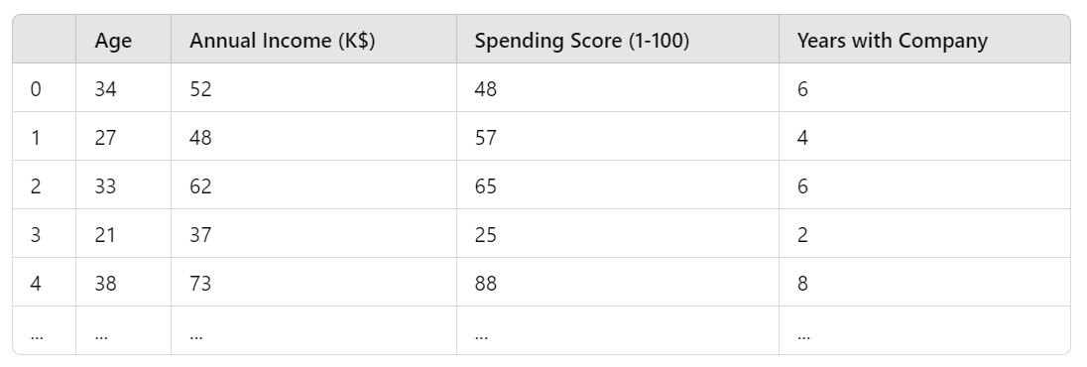

Slide 7



















Slide 8


Slide 9
Thank you

